Slide 1

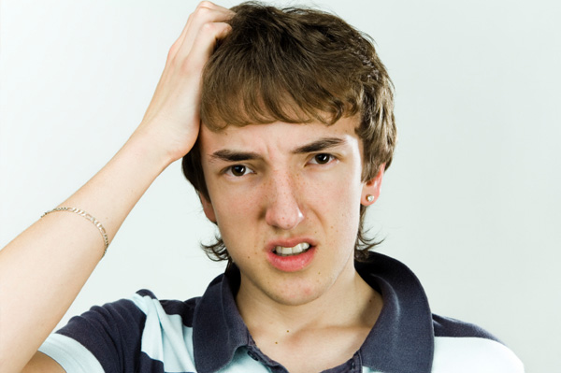
Teenage
Boy
Masturbation

Slide 2
WALT: Recognise the different changes in a teenage boys body.
WALT: Understand the terms public and private.

Slide 3

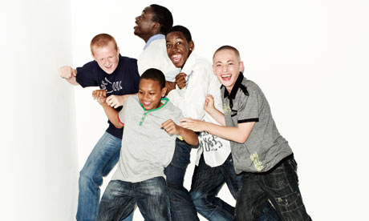
When you are a teenager your body begins to grow.
What can you see?

Slide 4
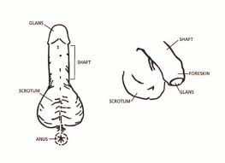

A boys private parts is called a penis.
What can you see?

Slide 5

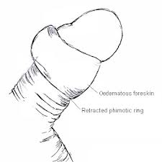
Sometimes when boys touch themselves or feel sexy they get an erection.
What can you see?

Slide 6


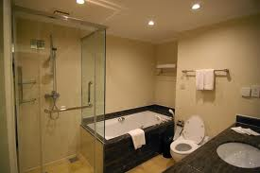
When this happens you should go to a private place, your bedroom or bathroom.
What can you see?

Slide 7
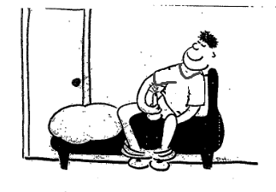

When you rub your penis you will enjoy it and then you will ejaculate.

Slide 8
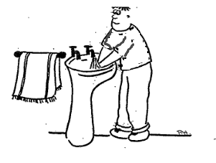

After you have finished you should wipe your penis with tissues and wash your hands.
What can you see?

Slide 9
Created by
Your Class
with a little help from
the
Teachers

