Slide 1
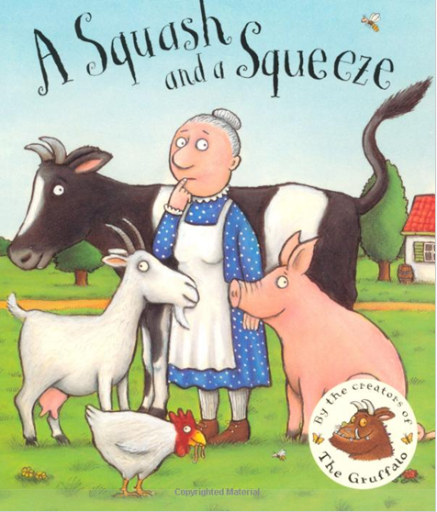

Slide 2
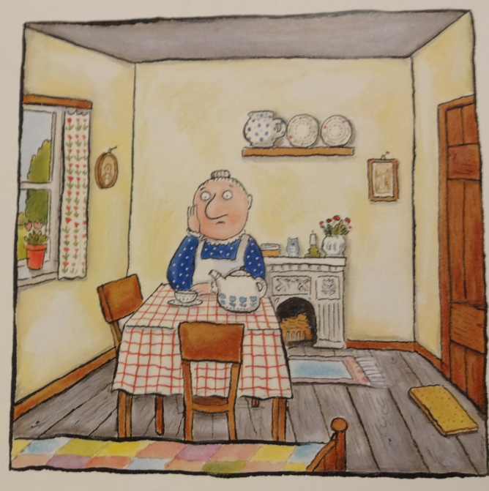
A little old lady lived all by herself, with a table and chairs and a jug on the shelf.

Slide 3
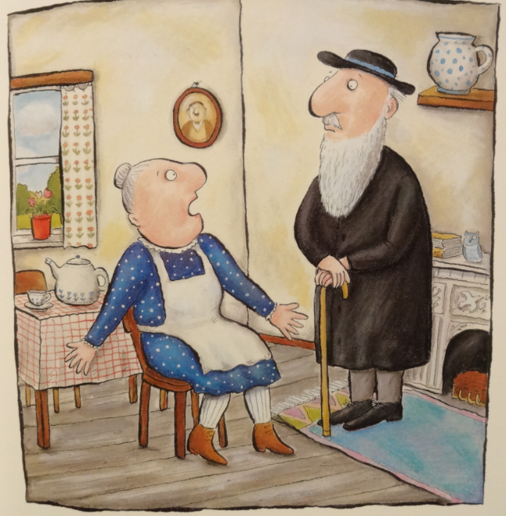
A wise old man heard her grumble and grouse, “There’s not enough room in my house. Wise old man, won’t you help me please? My house is a squash and a squeeze.”

Slide 4
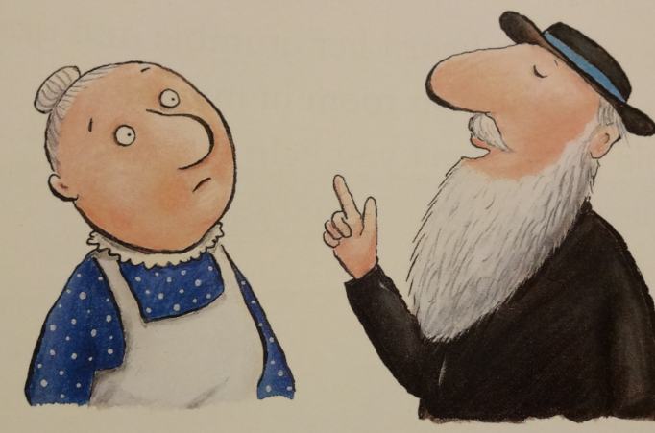
“Take in your hen,” said the wise old man

Slide 5
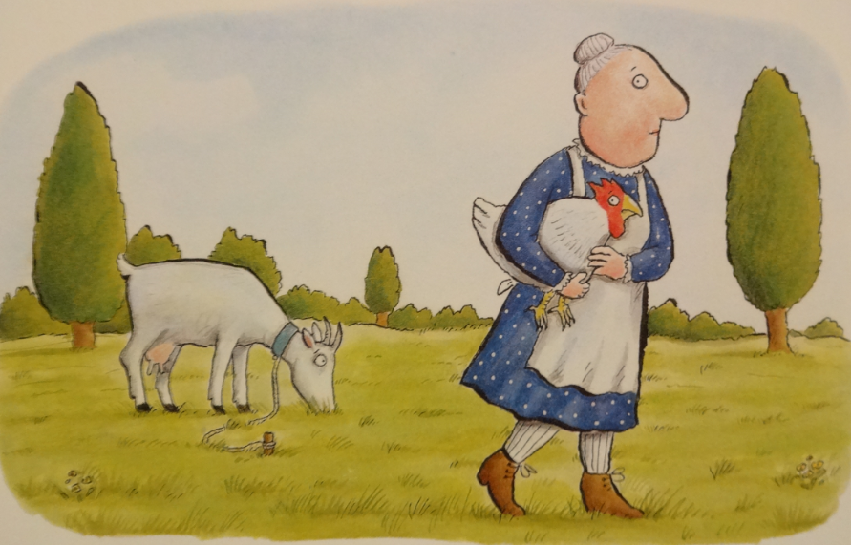
“Take in my hen? What a curious plan.”

Slide 6
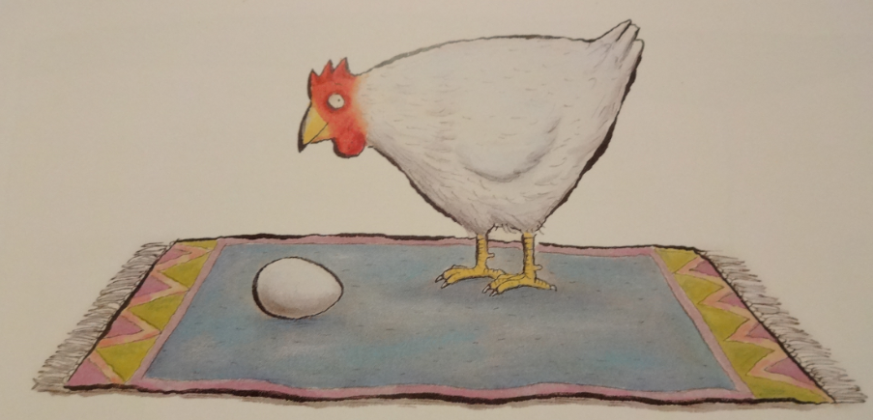
Well, the hen laid an egg on the fireside rug,

Slide 7
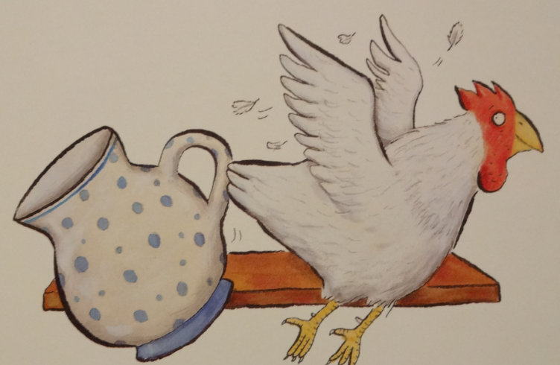
And flapped round the room knocking over the jug.

Slide 8
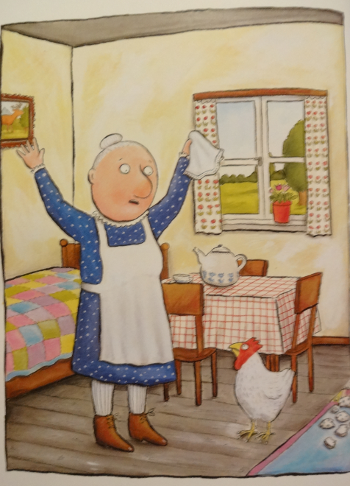
The little old lady cried, “What shall I do? It was pokey for one and it’s tiny for two. My nose has a tickle and there’s no room to sneeze. My house is a squash and a squeeze.”

Slide 9
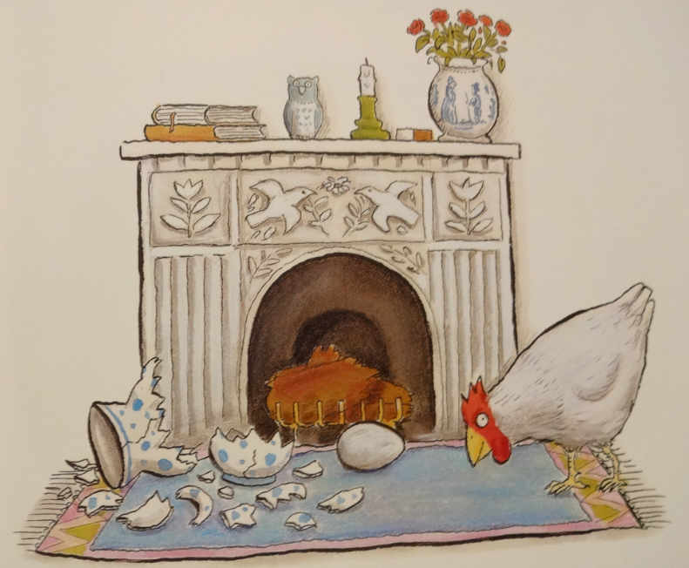
And she said, “Wise old man, won’t you help me please? My house is a squash and a squeeze.”

Slide 10
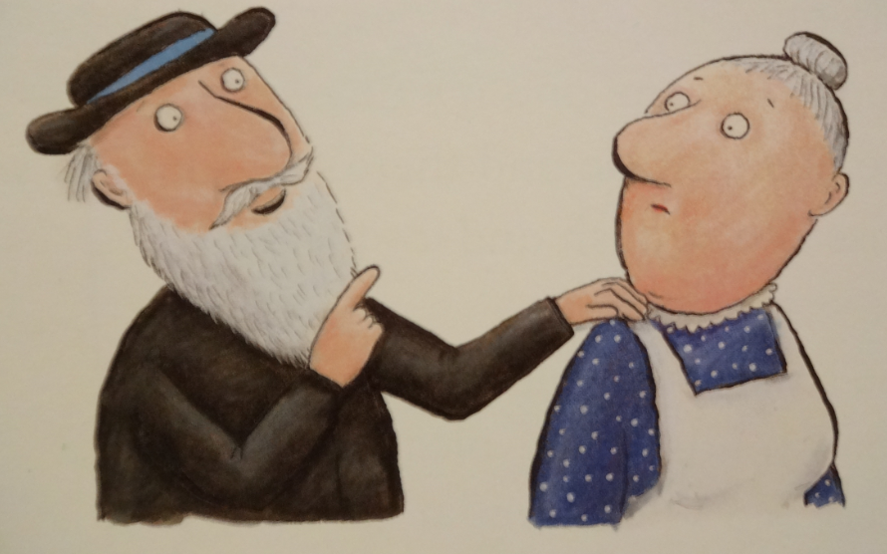
“Take in your goat,” said the wise old man.

Slide 11
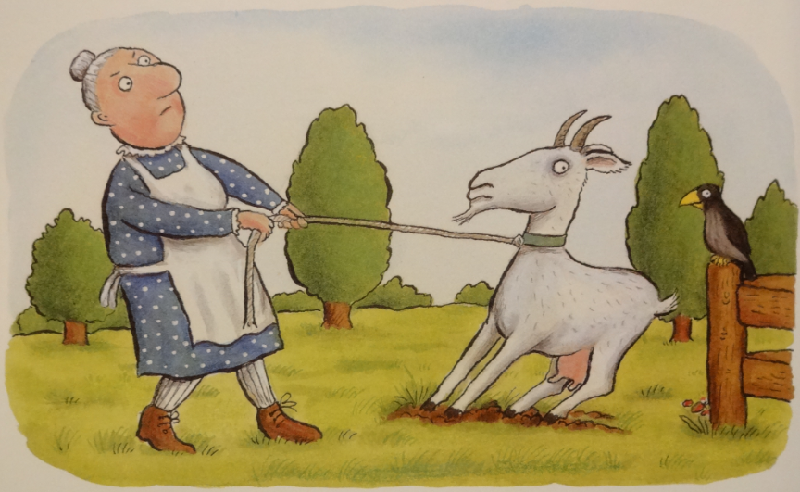
“Take in my goat? What a curious plan.”

Slide 12
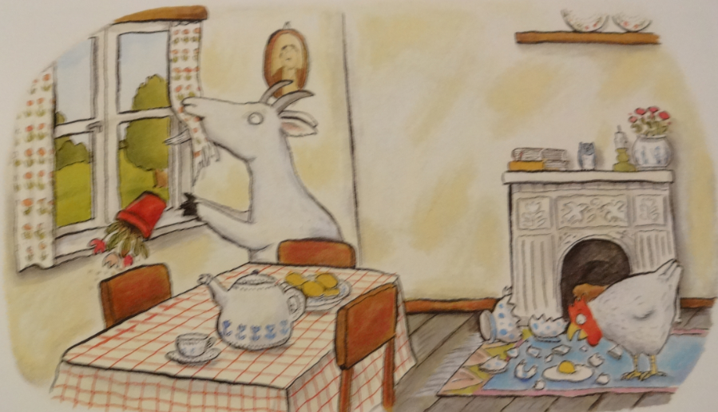
Well, the goat chewed the curtains and trod on an egg,

Slide 13
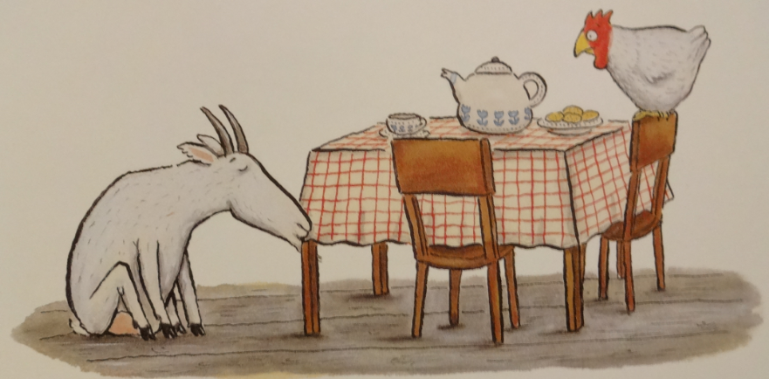
Then sat down to nibble on the table leg.

Slide 14
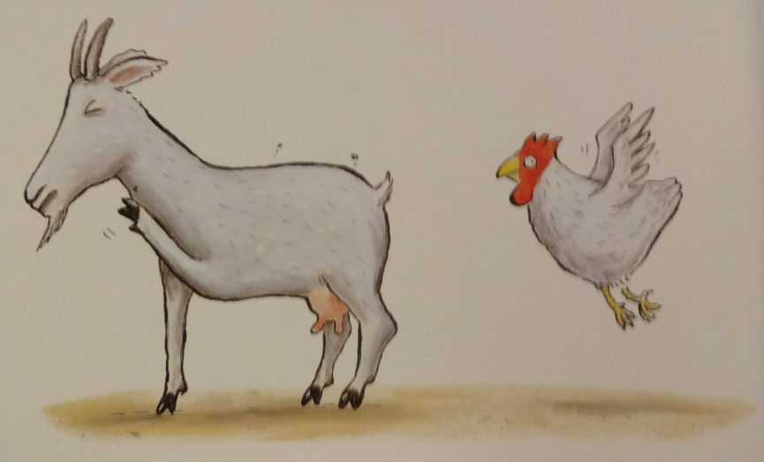
The little old lady cried, “Glory be! It was tiny for two and it’s titchy for three. The hen pecks the goat and the goat’s got fleas. My house is a squash and a squeeze.”

Slide 15
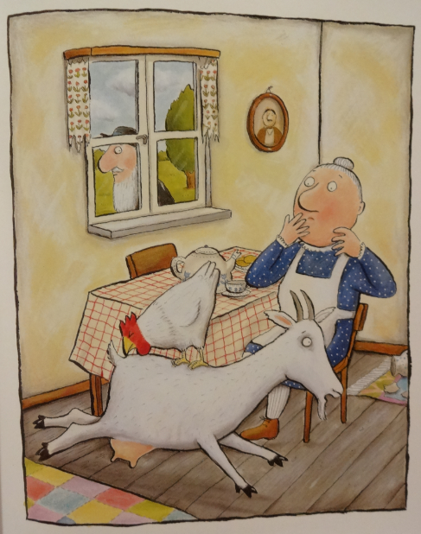
And she said, “Wise old man, won’t you help me, please? My house is a squash and a squeeze.”

Slide 16
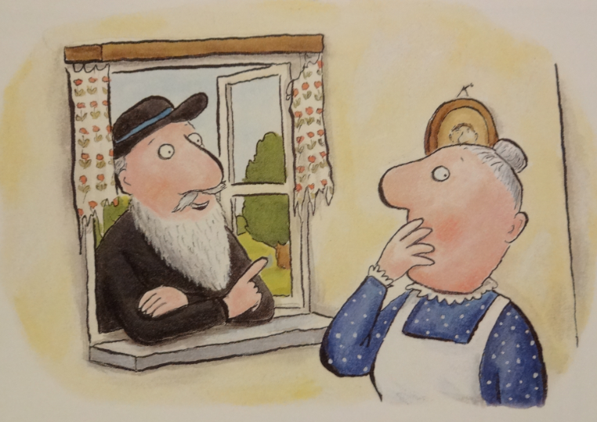
“Take in your pig,” said the wise old man.

Slide 17
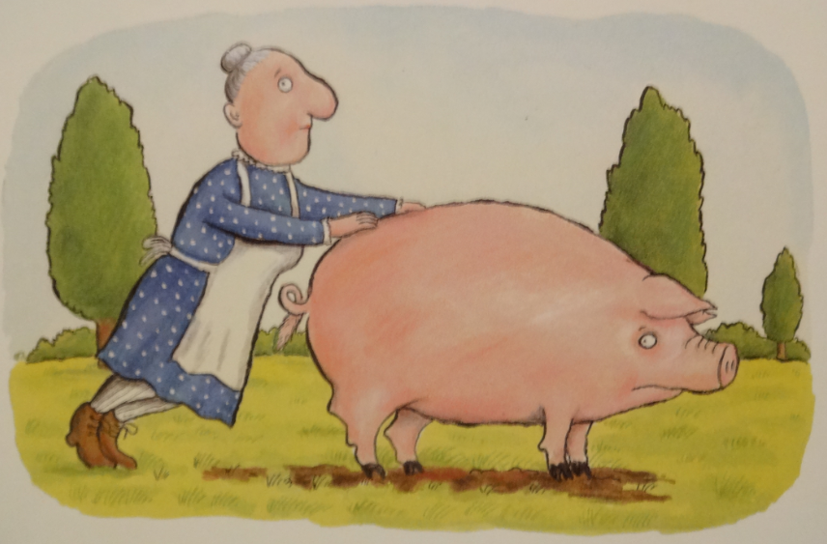
“Take in my pig? What a curious plan.”

Slide 18
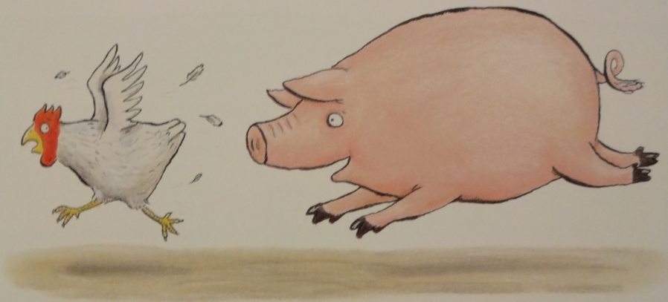
So she took in the pig who kept chasing the hen,

Slide 19
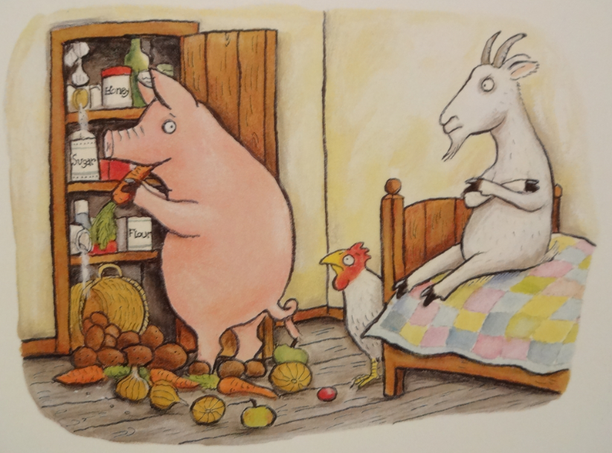
And raiding the larder again and again.

Slide 20
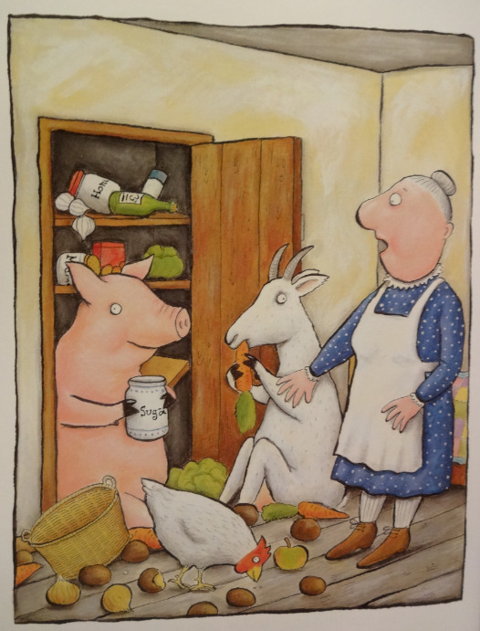
The little old lady cried, “Stop I implore! It was titchy for three and it’s teeny for four. Even the pig in the larder agrees. My house is a squash and a squeeze.”

Slide 21
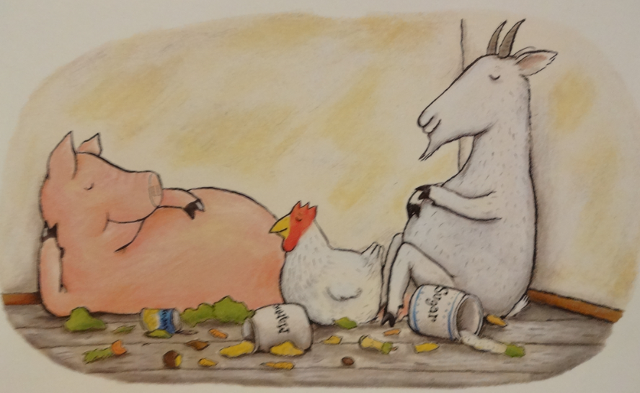
And she said, “Wise old man, won’t you help me, please? My house is a squash and a squeeze.”

Slide 22
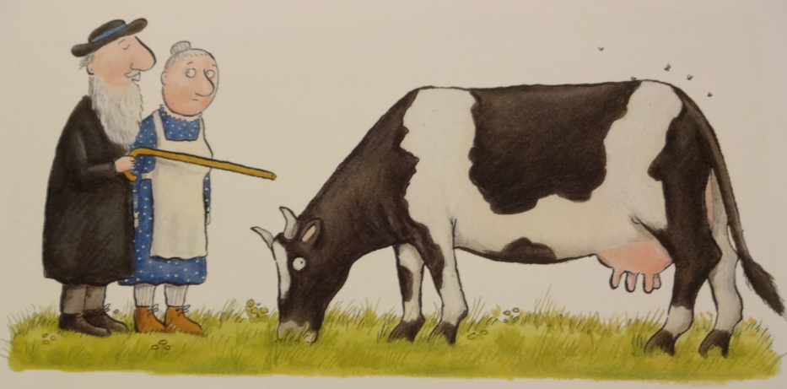
“Take in your cow,” said the wise old man,

Slide 23
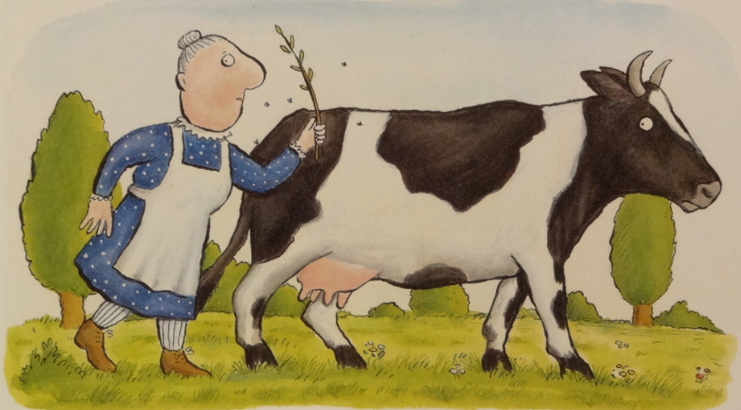
“Take in my cow? What a curious plan.”

Slide 24
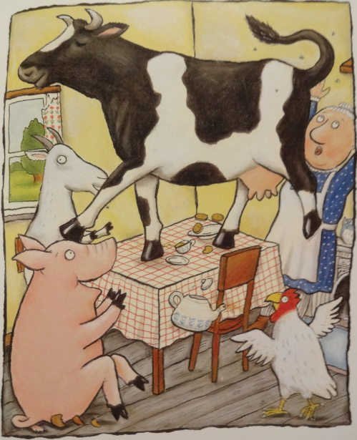
Well, the cow took one look and charged straight at the pig, then jumped on the table and tapped out a jig.

Slide 25
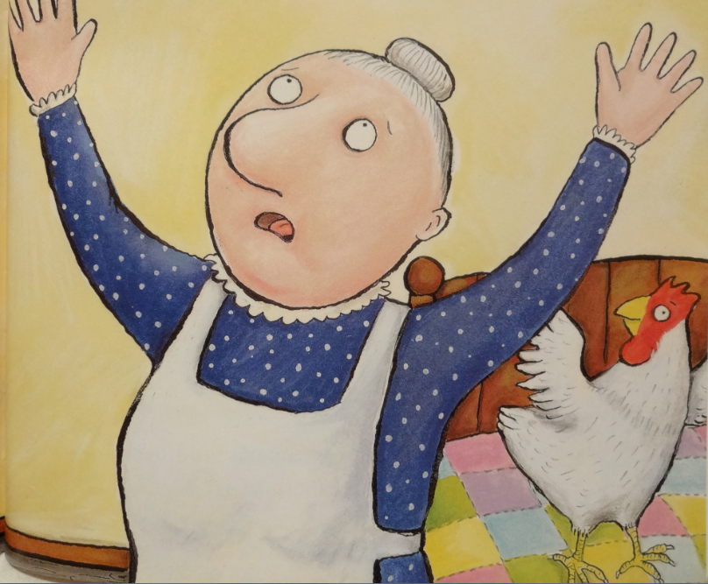
The little old lady cried, “Heavens alive! It was teeny for four and it’s weeny for five. I’m tearing my hair out, I’m down on my knees. My house is a squash and a squeeze.”

Slide 26
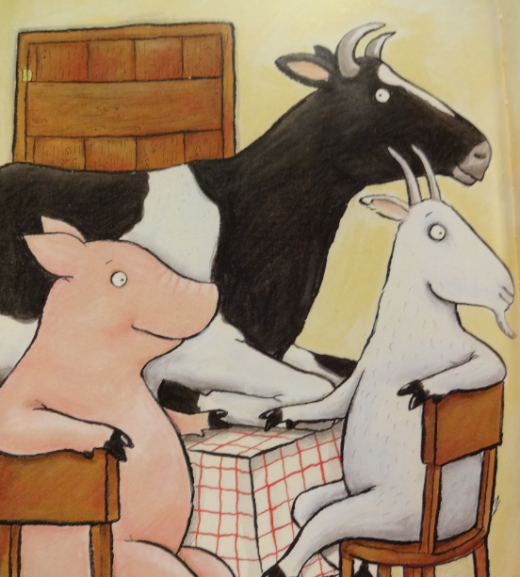
And she said, “Wise old man, won’t you help me, please? My house is a squash and a squeeze.”

Slide 27
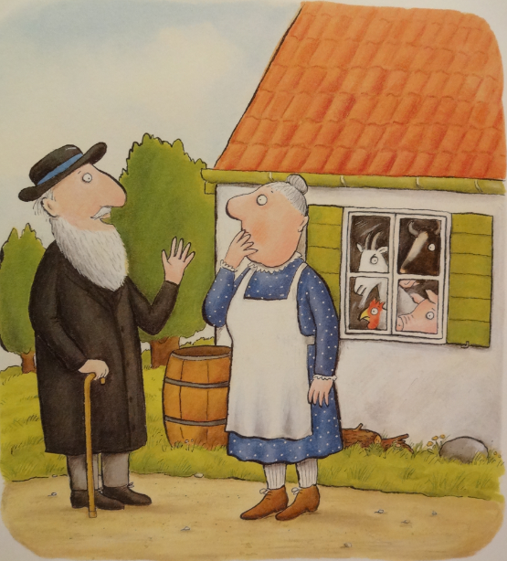
“Take then all out,” said the wise old man. “But then I’ll be back where I first began.”

Slide 28
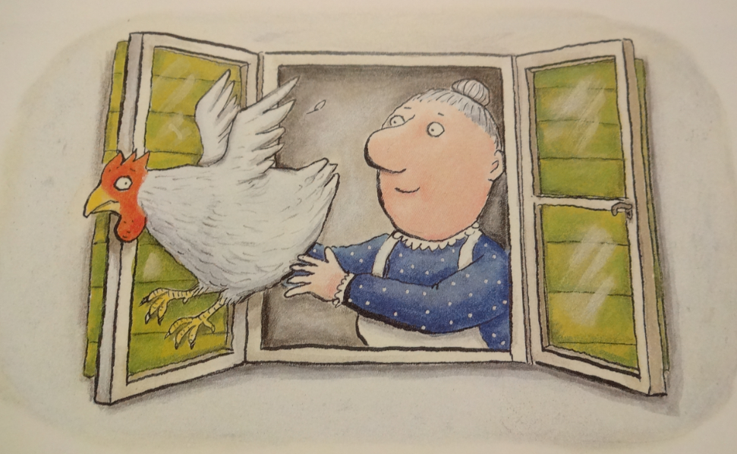
So she opened the window and out flew the hen. “That’s better – at last I can sneeze again.”

Slide 29
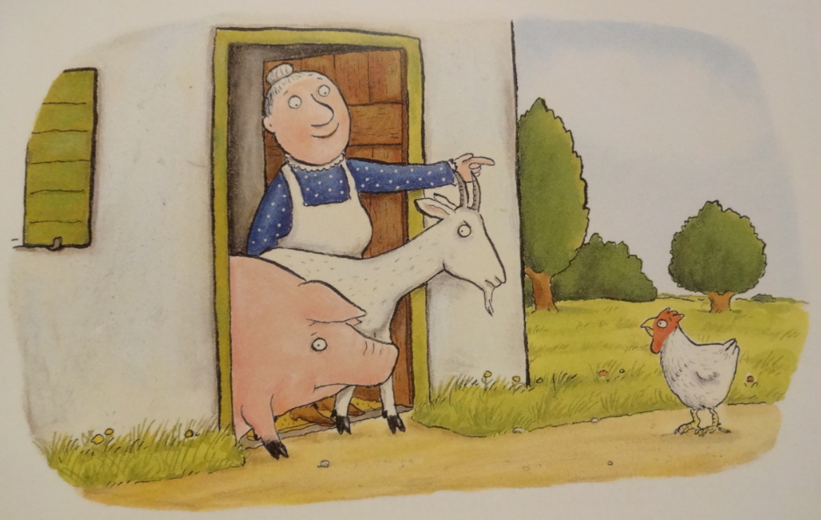
She shooed out the goat and she shoved out the pig. “My house is beginning to feel pretty big.”

Slide 30
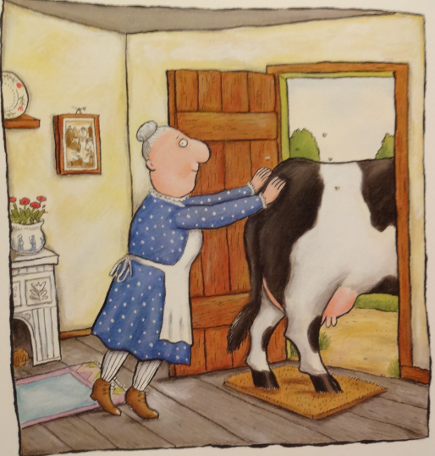
She huffed and she puffed and she pushed out the cow. “Just look at my house, it’s enormous now.”

Slide 31
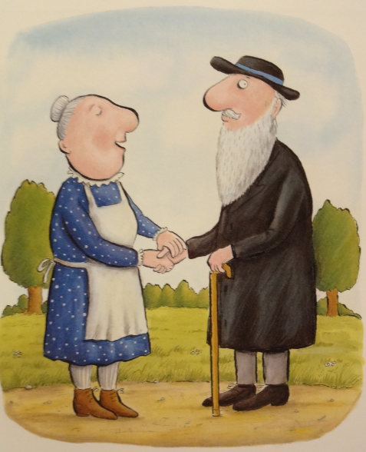
“Thank you, old man, for the work you have done. It was weeny for five, it’s gigantic for one. There’s no need to grumble and there’s no need to grouse. There’s plenty of room in my house.”

Slide 32
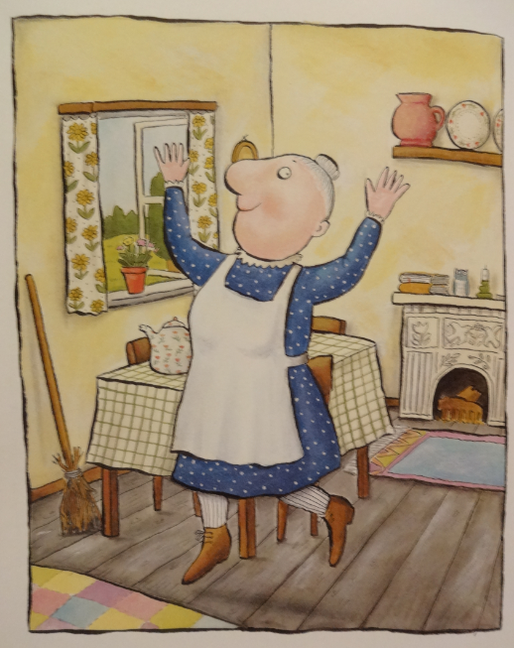
And now she’s full of frolics and fiddle-de-dees. It isn’t a squash and it isn’t a squeeze.

Slide 33
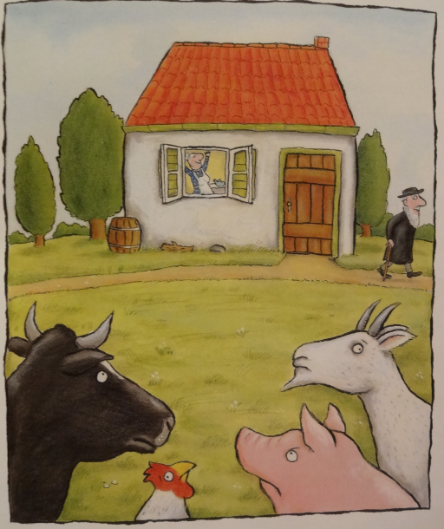
Yes, she’s full of frolics and fiddle-de-dees. It isn’t a squash or a squeeze.

