Slide 2
What is communication?
Communication is the transmission of a message from one person to another.

Slide 3
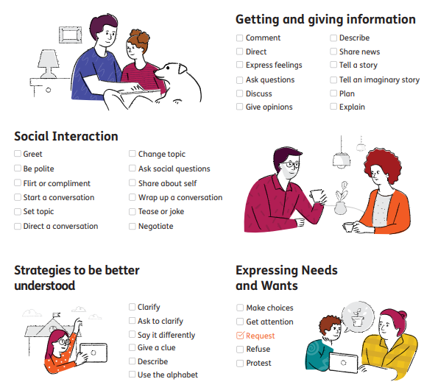
Why do we communicate?

Slide 4
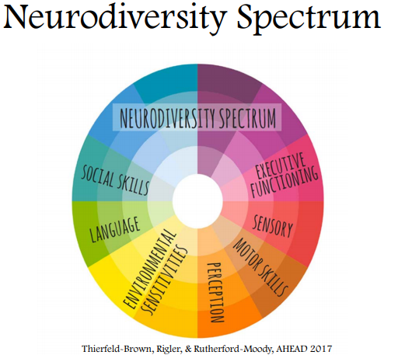
Neurodiversity
Our aim is communication and wellbeing – not forcing children to communicate in the way that we do
“Mouth words” are not the only (or best) way to communicate
Cannot and should not force communication
Notes:
Slightly off topic (for a good reason)
We can’t sacrifice well-being for communication skills as a person with poor wellbeing will not want to communicate with you

Slide 5
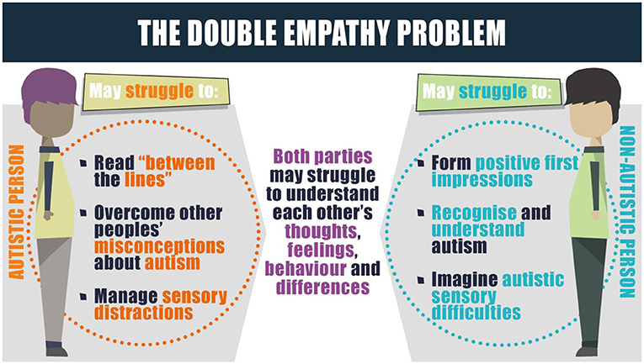
Damian Milton
Both sides need to make adjustments
Notes:
Damian Milton – Autistic academic and has an Autistic son
When Autistic people communicate with each other, they are just as effective as non-autistic people communication with each other → the ‘problems’ arise when autistic and non-autistic people communicate as their styles differ → BOTH sides need to make adjustments
In our case we are dealing with young children – we are the adults and our job is to be the best communication partner we can be

Slide 6
What do we do when someone doesn’t use speech for communication?
(or their speech is not enough/unclear/not consistent)
We teach them to use other methods of communication.
We call these AAC.
Notes:
And, like learning to speak, children need to be taught how to use these.

Slide 7
What is AAC?
“Augmentative and Alternative Communication (AAC) is a range of strategies and tools to help people who struggle with speech…AAC helps someone to communicate as effectively as possible, in as many situations as possible.” (communicationmatters.org.uk)

Slide 8
What is AAC?
Notes:
We will go through some of them today

Slide 9
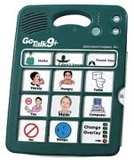
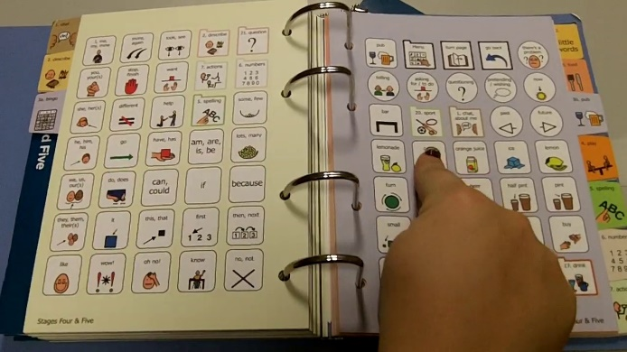
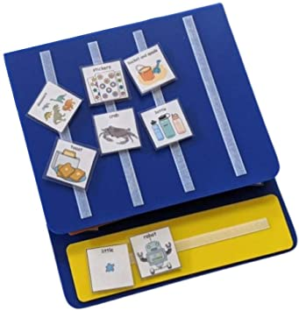
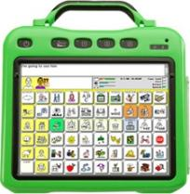
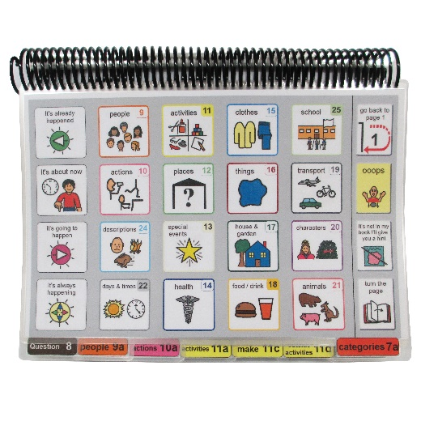
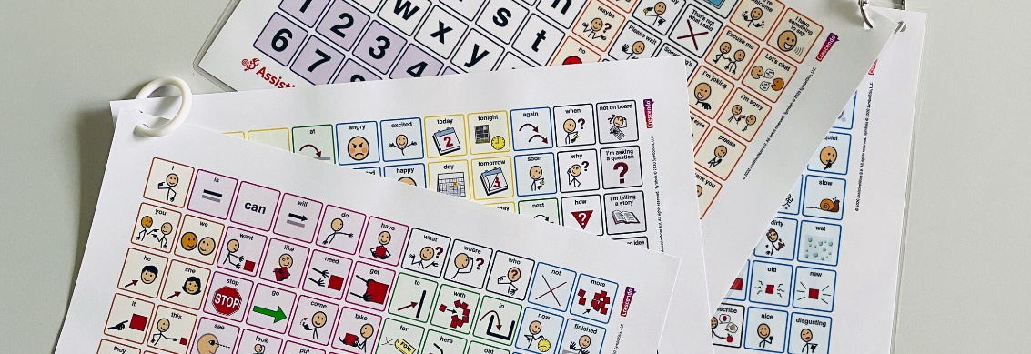
What is AAC?

Slide 10
What is AAC?
Supports strengths of the communicator
Supports making communication as quick, simple, and effective as possible
The aim of AAC is to build communicative competence to enable and full participation in all aspects of life (not just requesting)

Slide 12
What is AAC?

Slide 13
How do we communicate without words? (no-tech AAC)
Gesture
Pointing
Facial expression
Vocalisations
Crying
Laughing
Looking
Eye contact
Body language
We ALL use it – in fact it is a very important part of human communication. Speech without these things is actually very hard to interpret.

Slide 14
Why will we respond to nonverbal communication?
Because we use it ALL the time
It is an important and effective mode of communication
We respect and value all children and their communication methods
If we ignore it we are teaching the children that their communication is pointless (and they may stop trying)
It helps build trust and relationships
It help’s with self-esteem and emotional regulation
Early emotional learning in the right side of the brain prepares the brain for higher function learning
It builds the foundations for ‘symbolic’ communication → They are the FUNDAMENTALS OF COMMUNICATION

Slide 15
What are the “fundamentals of communication”?
Mutual enjoyment
Attention
Turn taking
Sequences of activity
Sharing personal space
Control arousal levels
Face reading
Body reading
Mind reading
Physical contact
Vocalising meaningfully
Attachment
Self-esteem
Sense of self
Empathy
Caring

Slide 16
What can we do to make sure the non-verbal communication is intentional and person-directed?
Wait for initiation – PAUSES
Be available but not expectant/demanding – position yourself at child’s level with appropriate space
Check gaze shift (not always)
Gradually make it a bit harder/increase demands (e.g. move away)
RESPOND consistently and with joy ☺
Practice in fun sessions (Intensive Interaction)
https://www.youtube.com/watch?v=UvIEwUbzF4c
Notes:
It is hard for parents to wait for initiation as you know your child so well you can anticipate their needs and you know what their non-intentional communication means

Slide 17
Makaton is a unique language programme that uses symbols, signs and speech to enable people to communicate. It supports the development of essential communication skills such as attention and listening, comprehension, memory, recall and organisation of language and expression.
With Makaton, signs are used, with speech, in spoken word order. This helps provide extra clues about what someone is saying.
The complete Makaton Language Programme comprises two vocabularies:
a Core Vocabulary of essential words or concepts presented in stages of increasing complexity. The Core Vocabulary is taught first and is the foundation of the programme
a much larger, open-ended, topic-based resource vocabulary providing an enormous bank of further signs and symbols covering broader life experiences and used in association with the Core Vocabulary as required

Slide 18
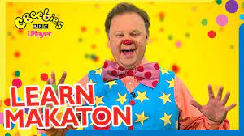

Slide 19
What is AAC?
We are now moving on to thinking about more ‘symbolic’ forms of communication
A symbol could be a spoken word, visual word or sign
Notes:
Symbolic communication is a term you are likely to see in your child’s PLP

Slide 20
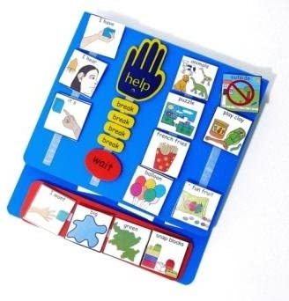
Picture
Exchange
Communication
System
Notes:
Very common
Who has/hasn’t heard?

Slide 21
The learner communicates by exchanging symbol(s)/photo(s)
Very specific curriculum, protocols and development (six phases).

Slide 22
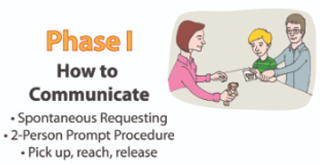
Just ONE symbol/photo at a time on the front of book
Very motivating items (preference assessment needed)
Entice - show item but do not do or say anything else
If this doesn’t work give a bit for free (Grandma’s secret)
Teach to the reach
Immediate response
Better (more independent) = more item or more time
Do not over prompt
Open hand cue can be used if needed
Need second person as a silent prompter from behind
https://www.youtube.com/watch?v=2y_s-x_k0Qk
Notes:
https://youtu.be/3He5MXkegNU
alternative video

Slide 23
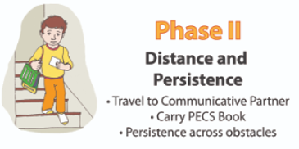
Entice
Gradually move yourself further away from child so they have to bring the symbol further
Then move the book away so they have to find the book then bring the symbol to you
Second silent prompter will still be needed
Better (more independent) = more item or more time
Also learning to carry book around (again via silent prompting)
https://youtu.be/H4WXYpfpavQ

Slide 24
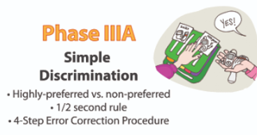
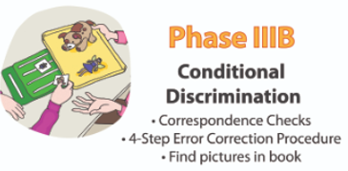
Entice → show all options available
Start with preferred and non-preferred or compatible and non-compatible
Then between 2 preferred/compatible
And build up until can discriminate between several symbols/pictures
Move symbols about on front of book so is not always on the left or right
LOTS of correspondence checks = offer all options and say “take it” → teach to the reach
If they reach for something they didn’t ask for or reject what they did ask for → correct using “4 step error correction procedure” (see next slide)

Slide 25
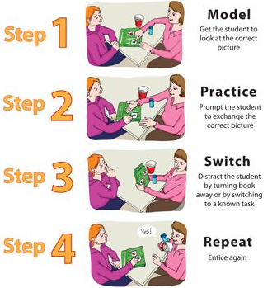
When they give the picture at this point you show them the item and praise them but don’t actually give it to him/her.
https://youtu.be/-OW6C10Cf4U
Better (correct picture) = more item or more time

Slide 26
Why do we use this method as a starting point?
It’s very motivating
They get great things out of it!
Children learn that they have the power to make choices and that these will be honoured
It’s simple and doesn’t require complicated equipment – everyone can do it consistently
It teaches initiation and persistence

Slide 27
Beyond requesting
PECS is a great starting point but it is not without it’s limitations.
We follow a “total communication” approach which means we do not follow one protocol to the letter.
Our pupils are individuals and our teaching practices reflect that.

Slide 28
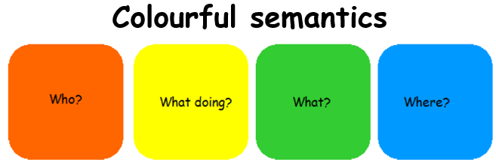
Subject-verb-noun type constructions are the basis of creative language.
Nouns are usually an area of strength → we need to work on the subject and verbs!
Notes:
You may have noticed my coloured titles!
PECS will be colour coded from day 1

Slide 30
Disclaimer
PECS does teach use of people and verbs but in their curriculum it comes later on.

Slide 31
Core vocabulary/communication
Research shows that around 50 words make up about half of what we say → these are called “core” words
Usually verbs, adjectives, and pronouns (less likely to be nouns).
Are useful across huge numbers of different situations.
Help, more, I, you, like, different, in, go
Notes:
Go – Let’s go, I’m going shopping, you need to go to the toilet, ready steady go, I’m ready to go, where did he go?
POWER words

Slide 32
How can we teach core vocabulary when it is so abstract?
Lots of modelling
Be one word ahead of your child
If child is not yet using, model one word
If child is using one word, model two
“Having a communication device doesn’t make you an effective communicator any more than having a piano makes you a musician” (Beukelman 1991)
https://www.youtube.com/watch?v=vB_brGVYg7w
Notes:
Go – Let’s go, I’m going shopping, you need to go to the toilet, ready steady go, I’m ready to go, where did he go?
A consistent board is very useful due to motor planning

Slide 33
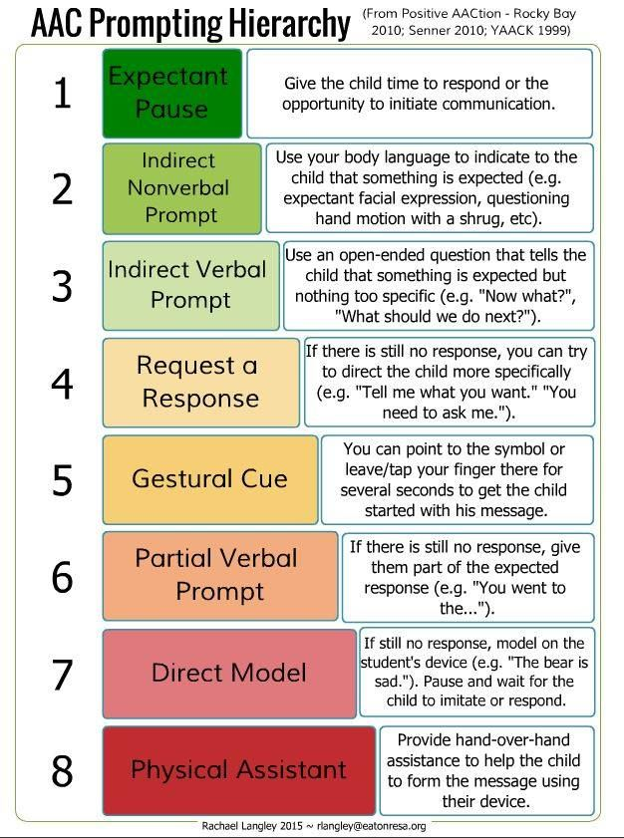
Notes:
We want to help whilst retaining child’s autonomy

Slide 34
Modelling phrases
Recent evidence is beginning to show that a lot of neurodivergent people are gestalt language processors – they learn language in ‘chunks’ sometimes called ‘scripts’ or ‘echolalia’ (can be a single word too)
We want to honour these scripts – acknowledge and extend
E.g. child says “mummy’s here” when they are upset
We want to model phrases that can be broken down and changed so that it is useful across contexts, remember a focus on core words, verbs and names
E.g. “Let’s go home” – useful and can be broken down into 3 useful words and modified for lots of contexts – let’s go bath, I go home, let’s eat pizza,
Notes:
Again modelling is key
Very individualised
Really have to listen to what your child’s says and it may not necessarily be clear
Just because your child is pre-verbal, doesn’t mean they aren’t processing language in this way
Have to be a detective – what your child says is not always what they mean
E.g. child may seem to say opposite as they are mimicking what other people say to them in that context; or may say a strange phrase they associate with a particular event

Slide 35
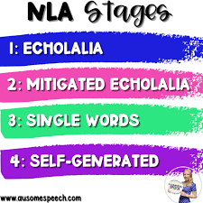
https://www.assistiveware.com/blog/gestalt-language-processing-aac

Slide 36
What is AAC?

Slide 37
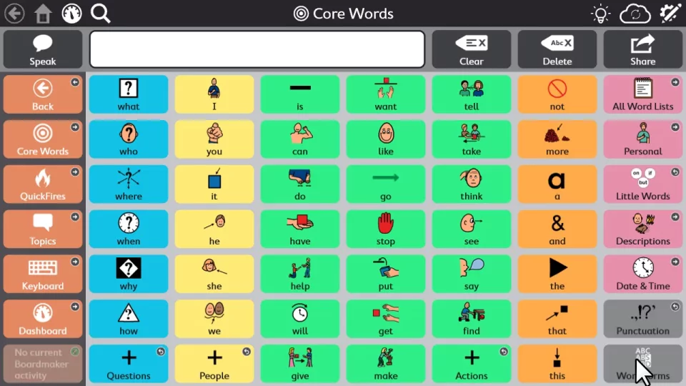

Slide 38
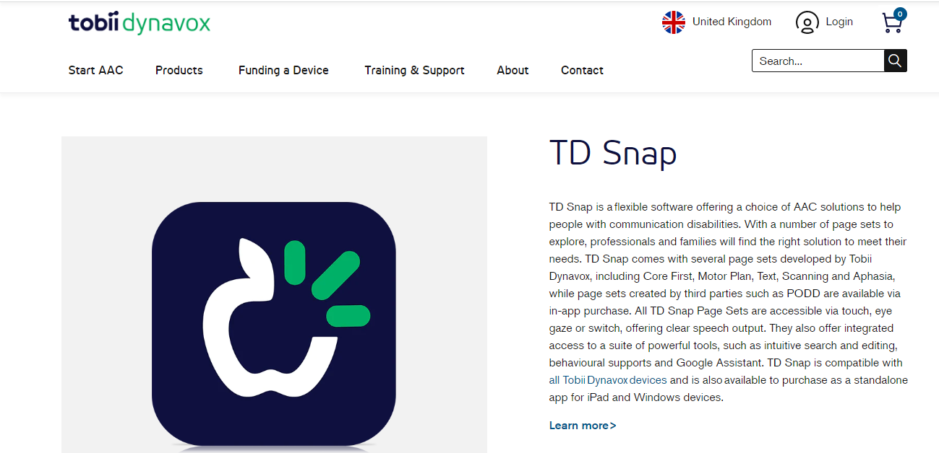

Slide 39
What is AAC?
Notes:
Reminder that AAC comes in all shapes and sizes
It’s not necessarily one or the other – can use both

Slide 40
AAC at Northway
There is no one size fits all approach → at this early stage of your child’s learning career, we will introduce a range of communication opportunities

Slide 41
Damian Milton
Both sides need to make adjustments
Notes:
Reminder that communication is 2 way

Slide 42
Why do we communicate?
Notes:
There are lots of reasons to communicate

Slide 43
Thank you so much for listening.
ekorel@northway.barnet.sch.uk

